Slide 1




A1: Needfinding

Slide 2
Intro

Slide 3


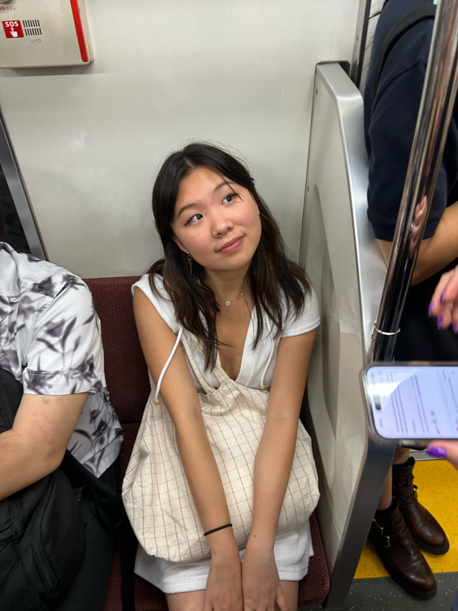
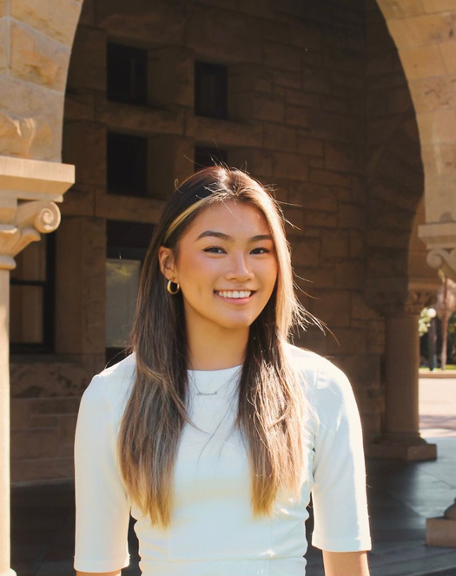
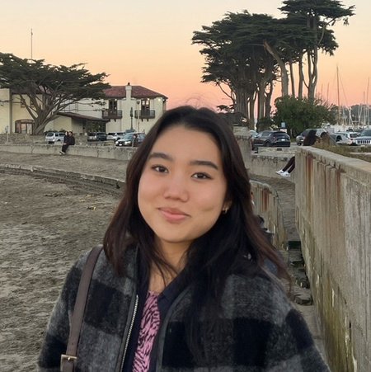
Team Members
Emily Deng
Jenna Kim
Ariane Lee

Slide 4

Problem Domain
General Constraints:
Reachable audience
Within studio theme
Self Imposed Constraints:
Some sort of connection
Ex: not B2B SASS

Slide 5

Problem Domain
General Constraints:
Reachable audience
Within studio theme
Self Imposed Constraints:
Some sort of connection
Ex: not B2B

Slide 6

Problem Domain
General Constraints:
Reachable audience
Within studio theme
Self Imposed Constraints:
Some sort of connection
Ex: not B2B

Slide 7

Problem Domain
General Constraints:
Reachable audience
Within studio theme
Self Imposed Constraints:
Some sort of connection
Ex: not B2B

Slide 8

Problem Domain
General Constraints:
Reachable audience
Within studio theme
Self Imposed Constraints:
Some sort of connection
Ex: not B2B

Slide 9

Mothers!

Slide 10
Why Mothers?
Have needs/problems we have a stake in

Slide 11
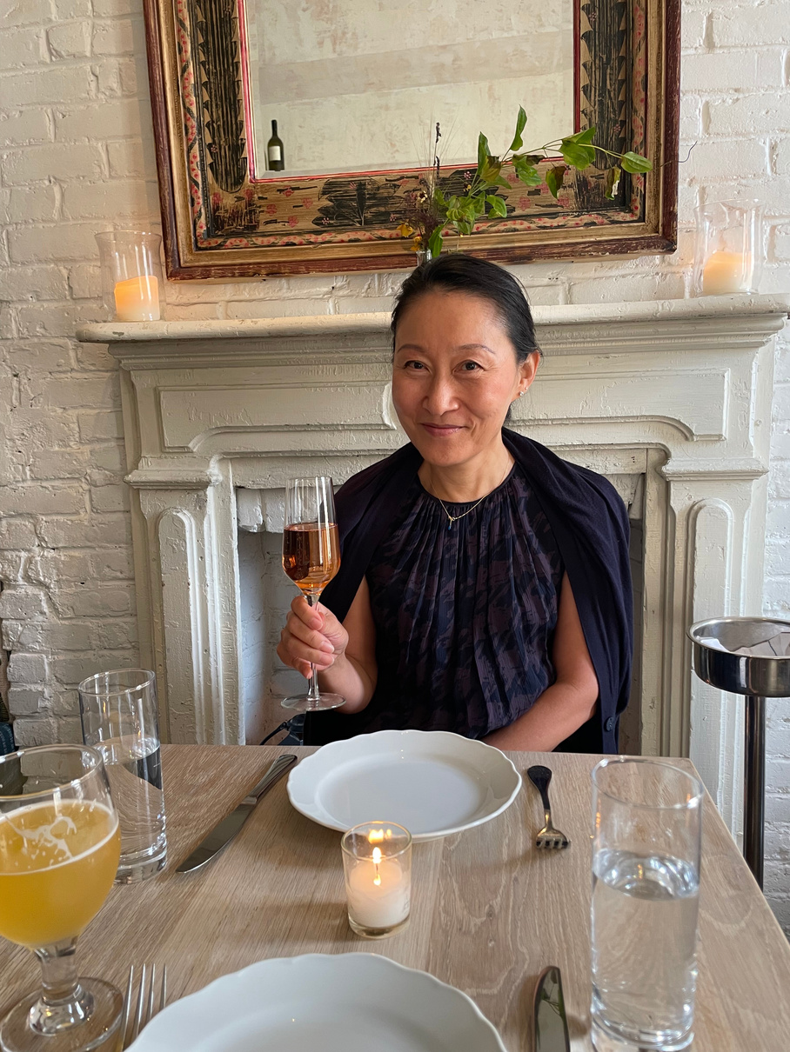

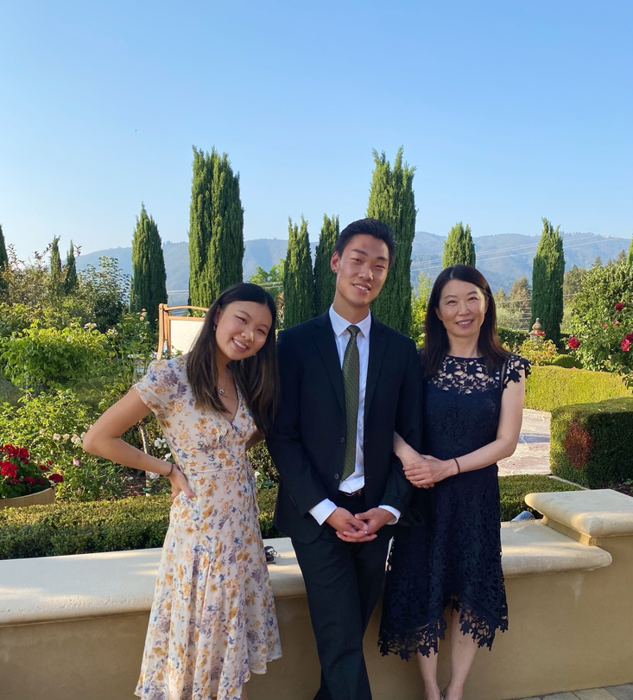
Why Mothers?
Have needs/problems we have a stake in

Slide 12

Why Mothers?
Have needs/problems we have a stake in

Slide 13
Why Mothers?
Have needs/problems we have a stake in
Around 25% of the population (source)
Large demographic -> impactful
Accessible audience

Slide 14
Needfinding
Methodology

Slide 15


Candidate Considerations
Looking for diversity in
socio-economic status
occupations
ethnicities
age/number of kids

Slide 16



How were they recruited?
Asked for volunteers via
Cold emails
Nextdoor
(Polite) In-person asks
Second-degree connections from class, friends, etc.

Slide 17
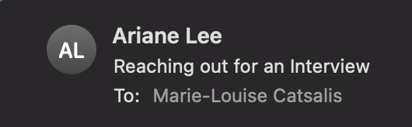
How were they recruited?
Asked for volunteers via
Cold emails
Nextdoor
(Polite) In-person asks
Second-degree connections from class, friends, etc.

Slide 18
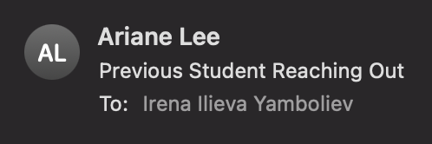
How were they recruited?
Asked for volunteers via
Cold emails
Nextdoor
(Polite) In-person asks
Second-degree connections from class, friends, etc.

Slide 19
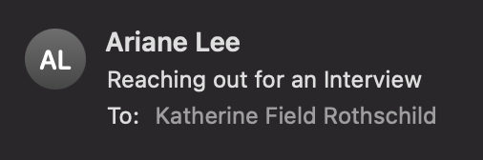
How were they recruited?
Asked for volunteers via
Cold emails
Nextdoor
(Polite) In-person asks
Second-degree connections from class, friends, etc.

Slide 20
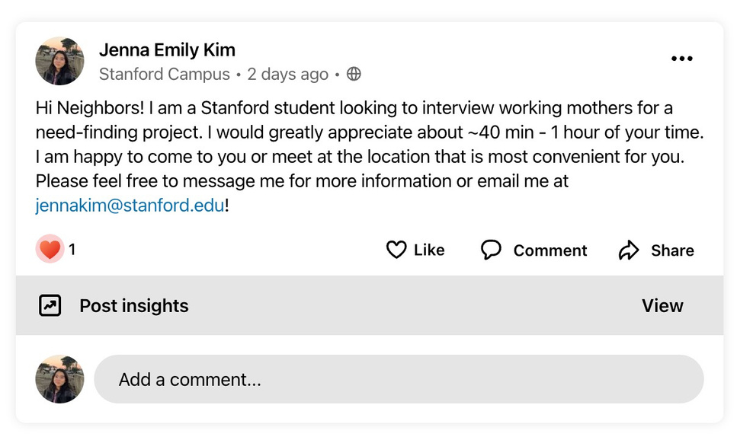
How were they recruited?
Asked for volunteers via
Cold emails
Nextdoor
(Polite) In-person asks
Second-degree connections from class, friends, etc.

Slide 21

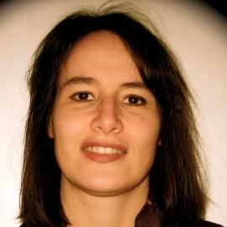

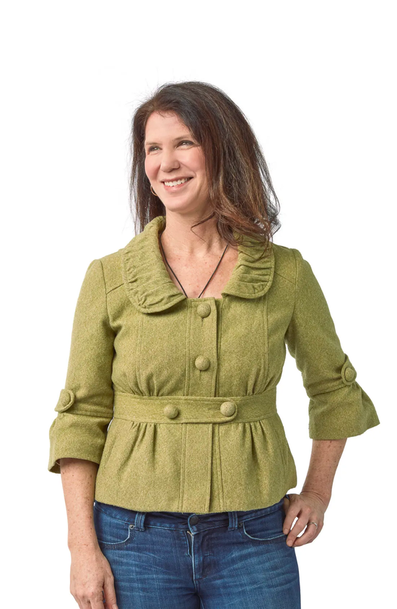
Interviewees
Wei
Ann
Marie
Teresa
Stay-at-Home Mom
Mother of 1 (a. 7)
Entrepreneur
Mother of 3 (a. 20, 17, 10)
Piano Professor / RF
Mother of 2 (a. 18, 15)
680 Chef
Mother of 5 (a. 23-40s)

Slide 22

Questions Asked
What is your favorite tool/product that you use?
Walk me through your daily routine, starting from when you wake up to when you go to bed.
What are some processes you feel are redundant or inefficient?
How do you split childcare responsibilities with your partner?
How did being a mother impact your career?
What surprised you most about motherhood?

Slide 23
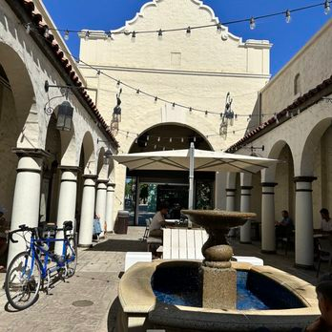
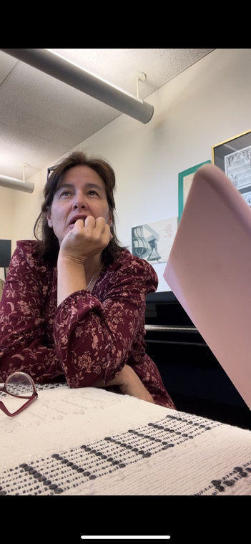
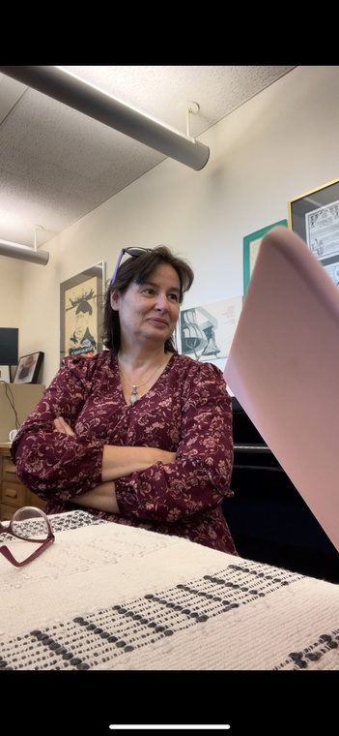
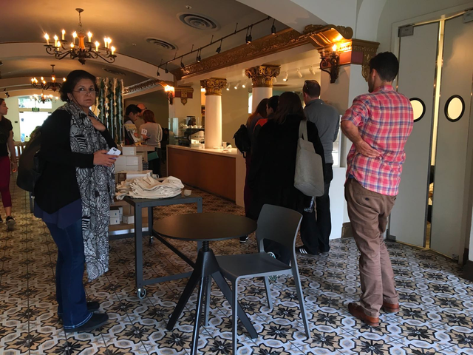
Where
Classrooms
Dorms
Offices
Coffee Shops
Phone Call
Pictures & Relevant Artifacts

Slide 24





HAS 3 CHILDREN WITH TWO PARTNERS
ANN
Ann co-parents her 17 & 20 year-old with her ex-husband while raising her 10-year-old with her current husband. This requires Ann to manage familial responsibilities and clearly coordinate between two families and households.
EXTREME USER
SUCCESSFUL ENTREPRENEUR
Ann is the founder of two successful companies. She created her first business, which was a parenting social network called Maya’s Mom, after the birth of her second child. Maya’s Mom was later acquired by Johnson & Johnson. She is currently the CEO of Hatch, a sleep wellness company that Ann co-founded with her current husband. Hatch initially only sold products for babies but now creates lights + more for everyone.

Slide 25
Team Member Roles
Ann
Notetaker: Jenna, Interviewer: Emily
Marie
Notetaker: Jenna, Interviewer: Ariane
Teresa
Notetaker: Ariane, Interviewer: Emily
Wei
Notetaker: Emily, Interviewer: Jenna

Slide 26
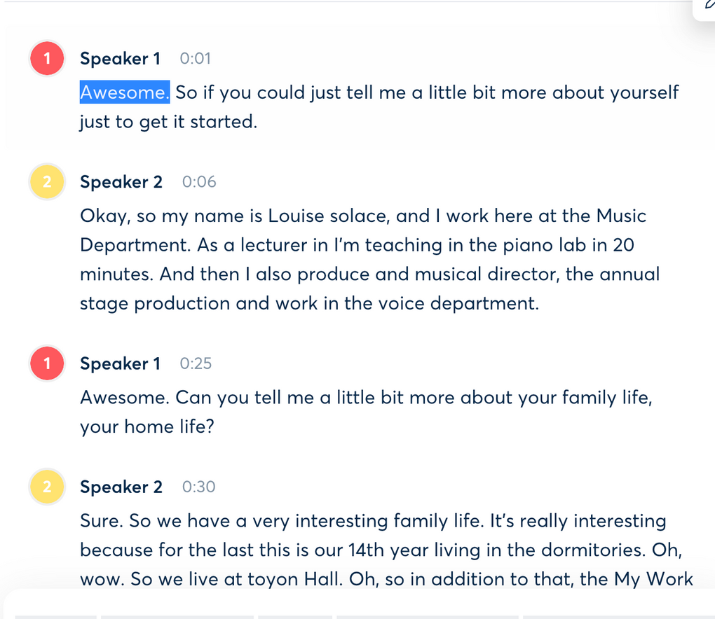
Apparatus
Phones- recording videos & taking images
Otter.ai- transcribing audio

Slide 27
Interview Results & Analysis

Slide 28
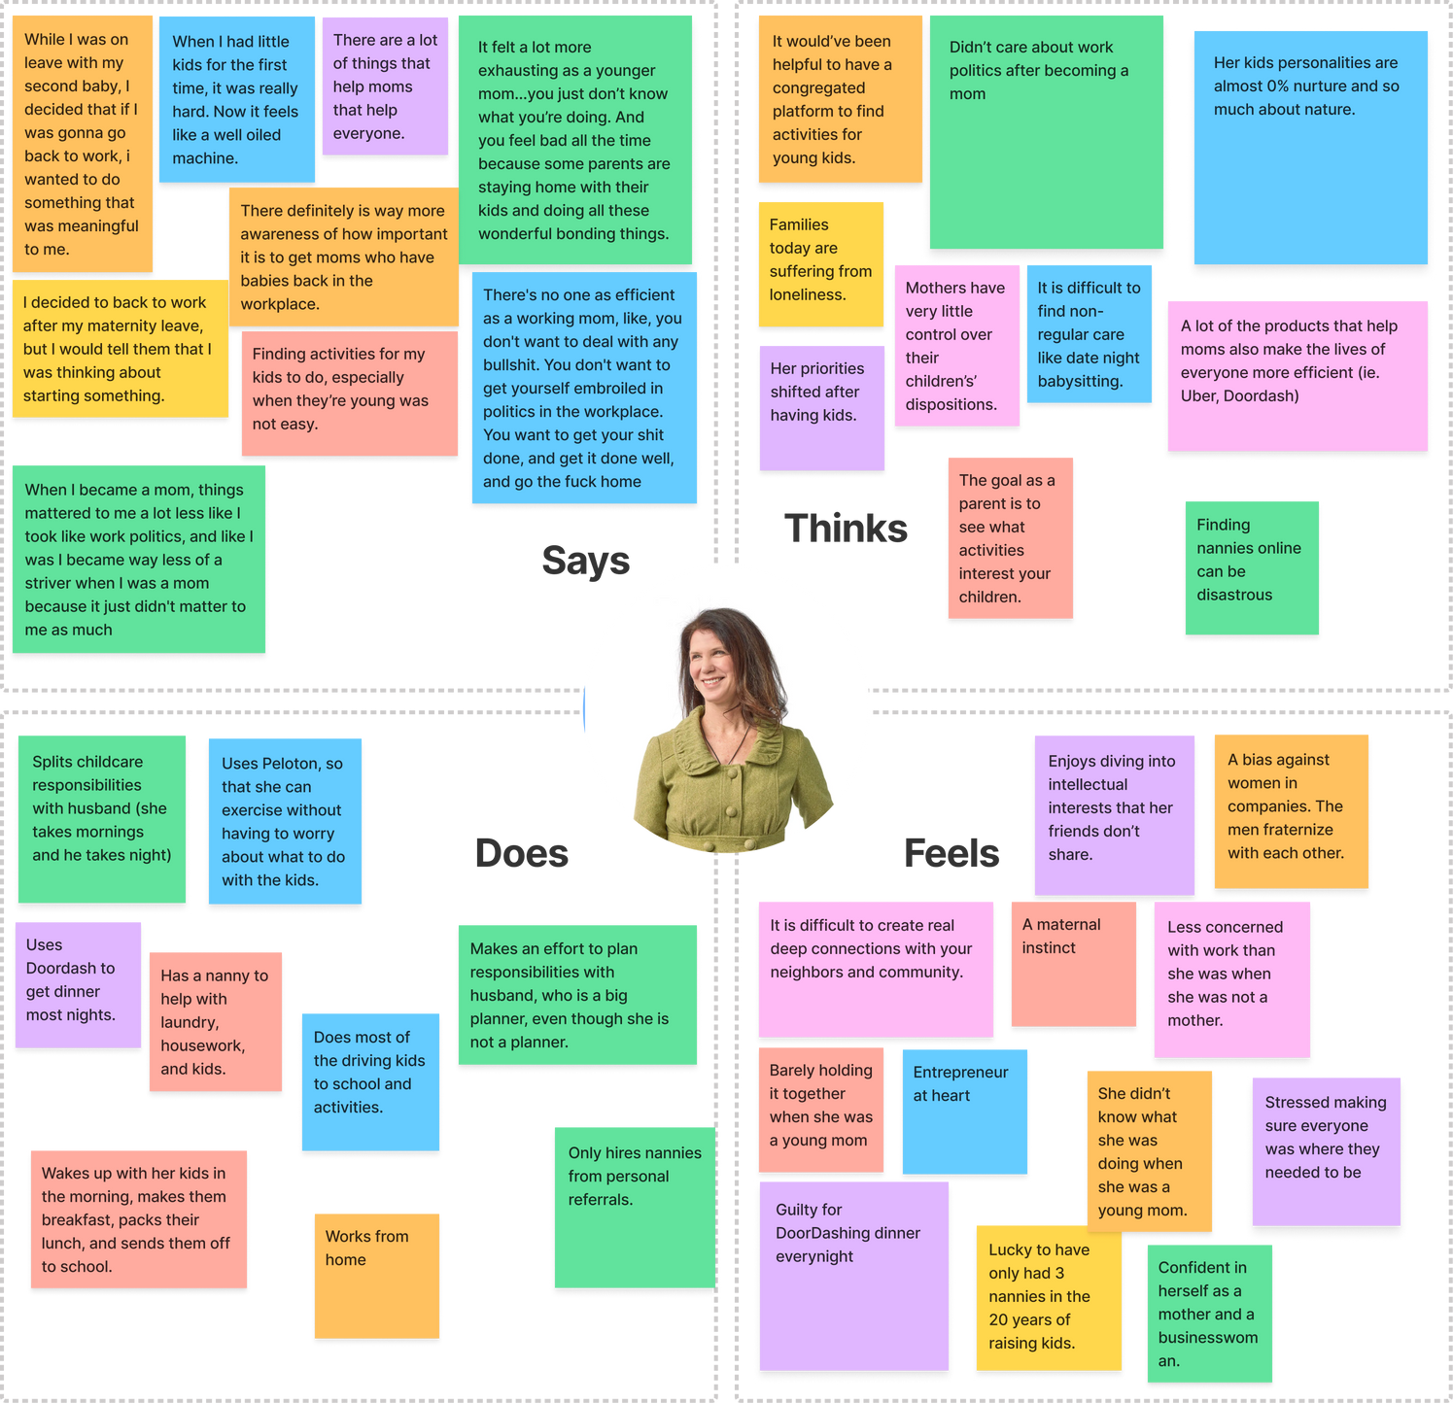
Key Insights

Slide 29
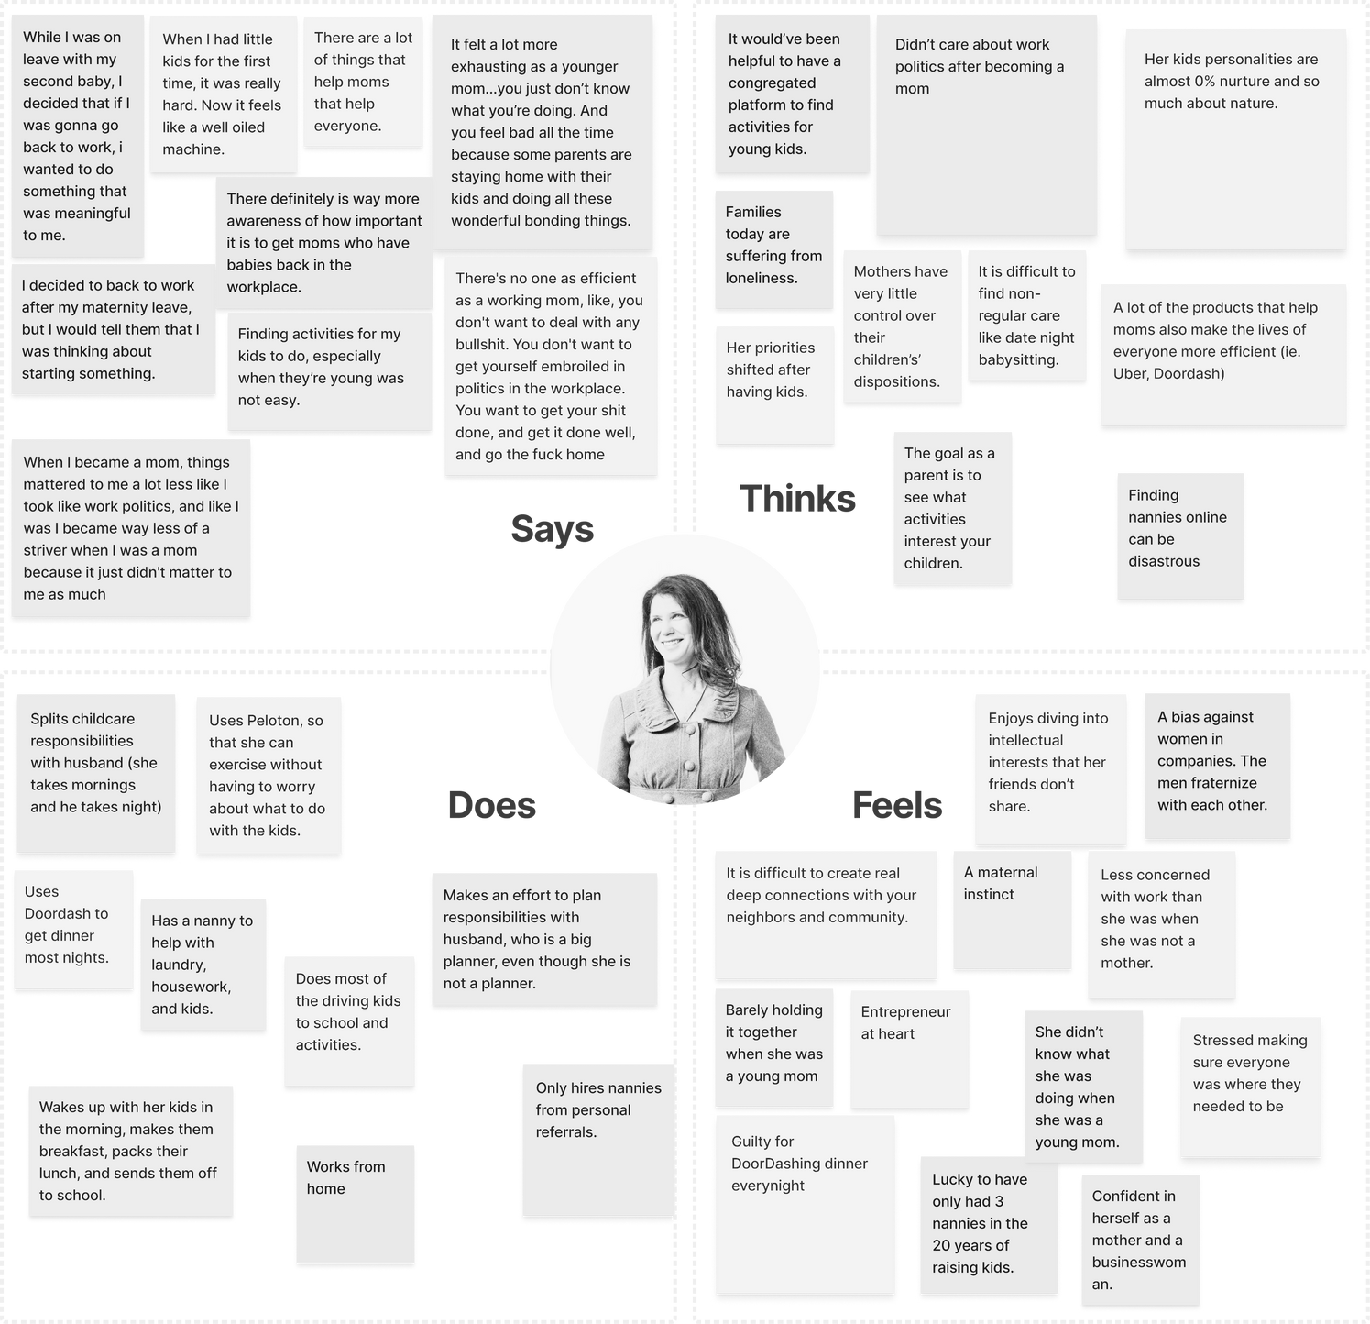
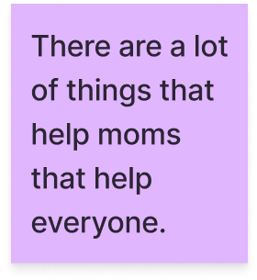
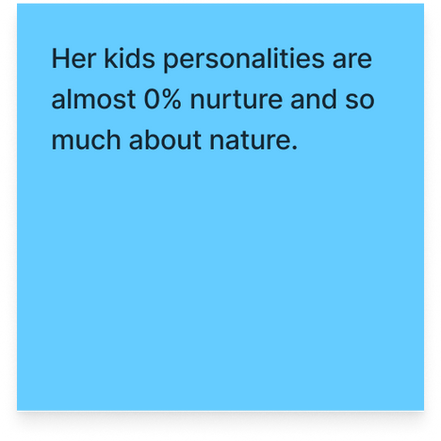
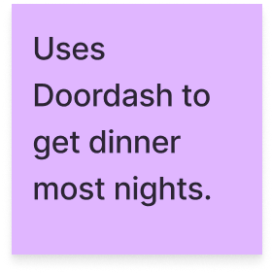
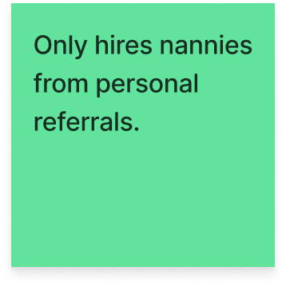
Key Insights

Slide 30
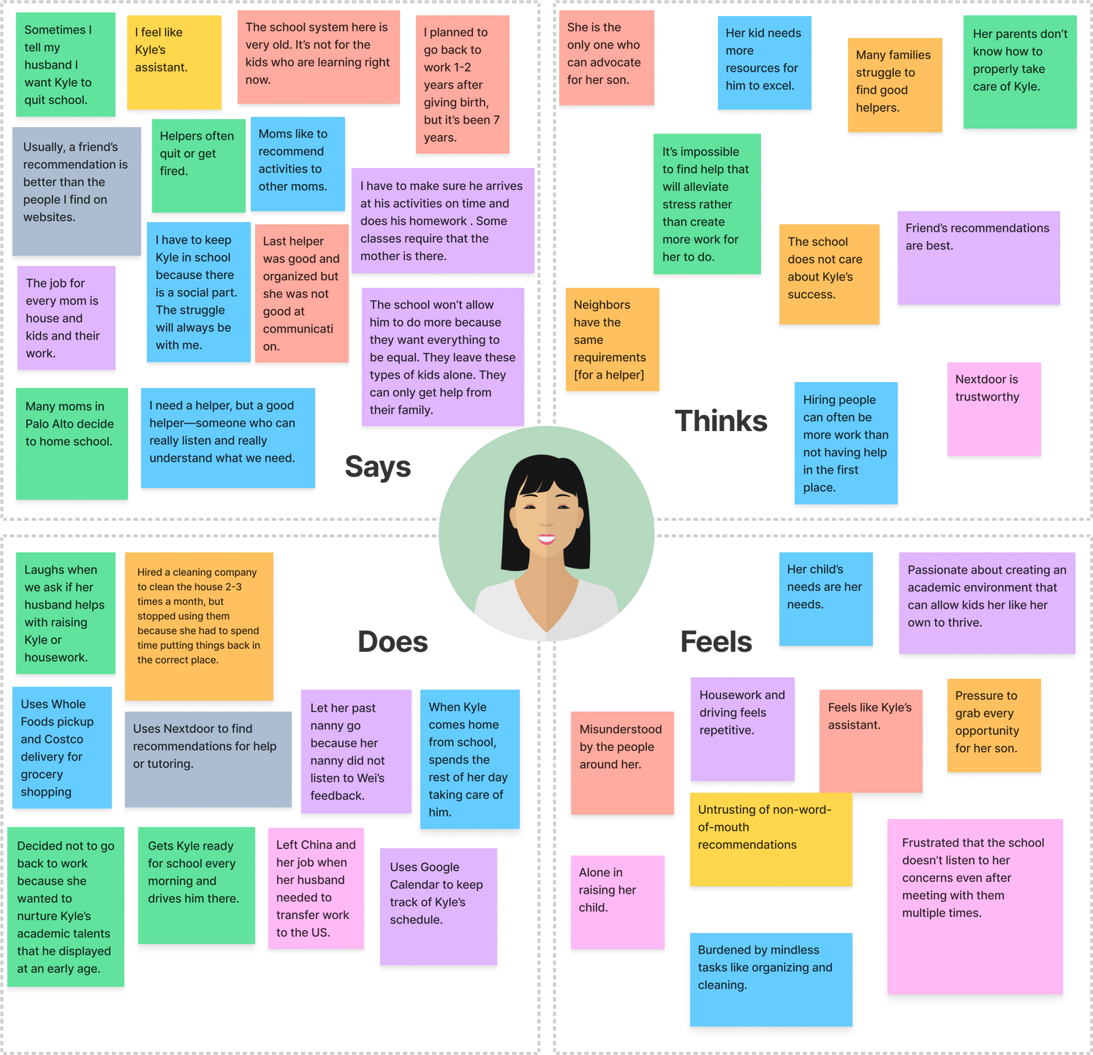
Key Insights

Slide 31
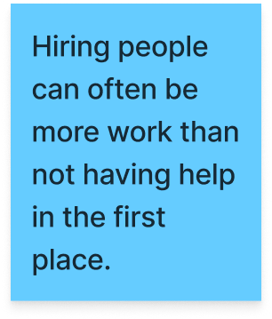
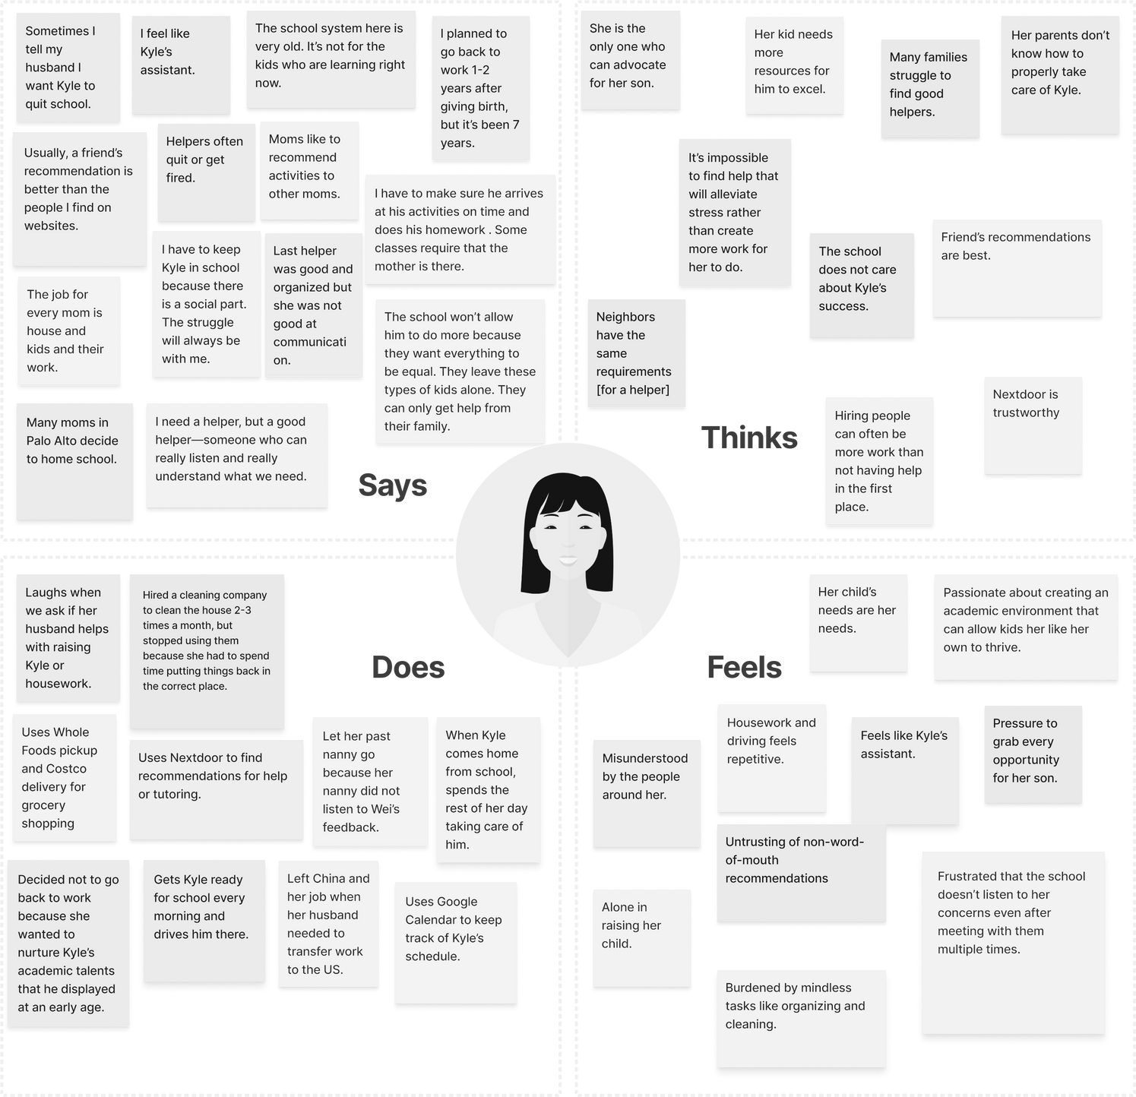
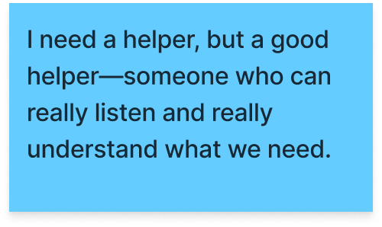
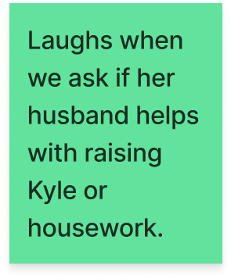
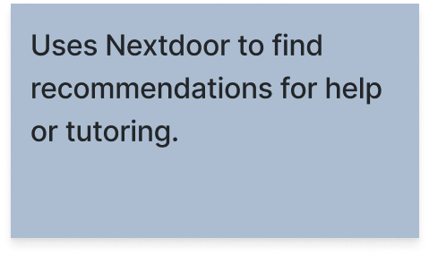
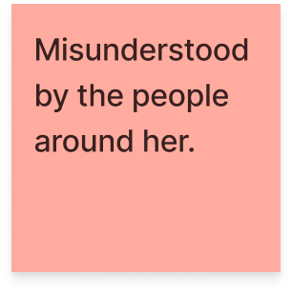
Key Insights

Slide 32
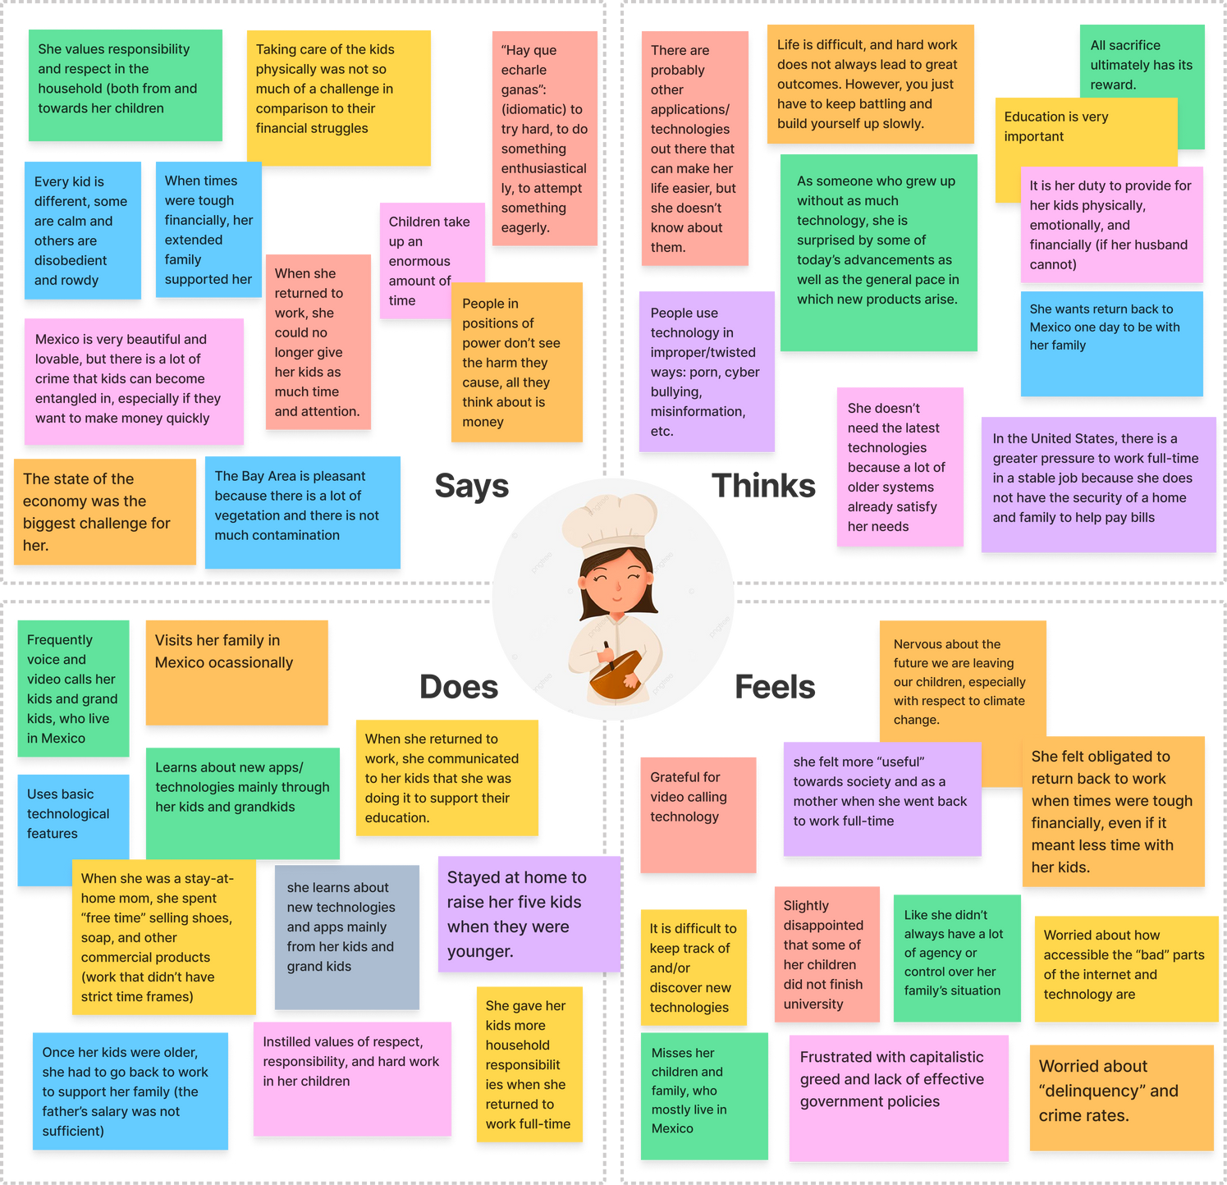
Key Insights

Slide 33
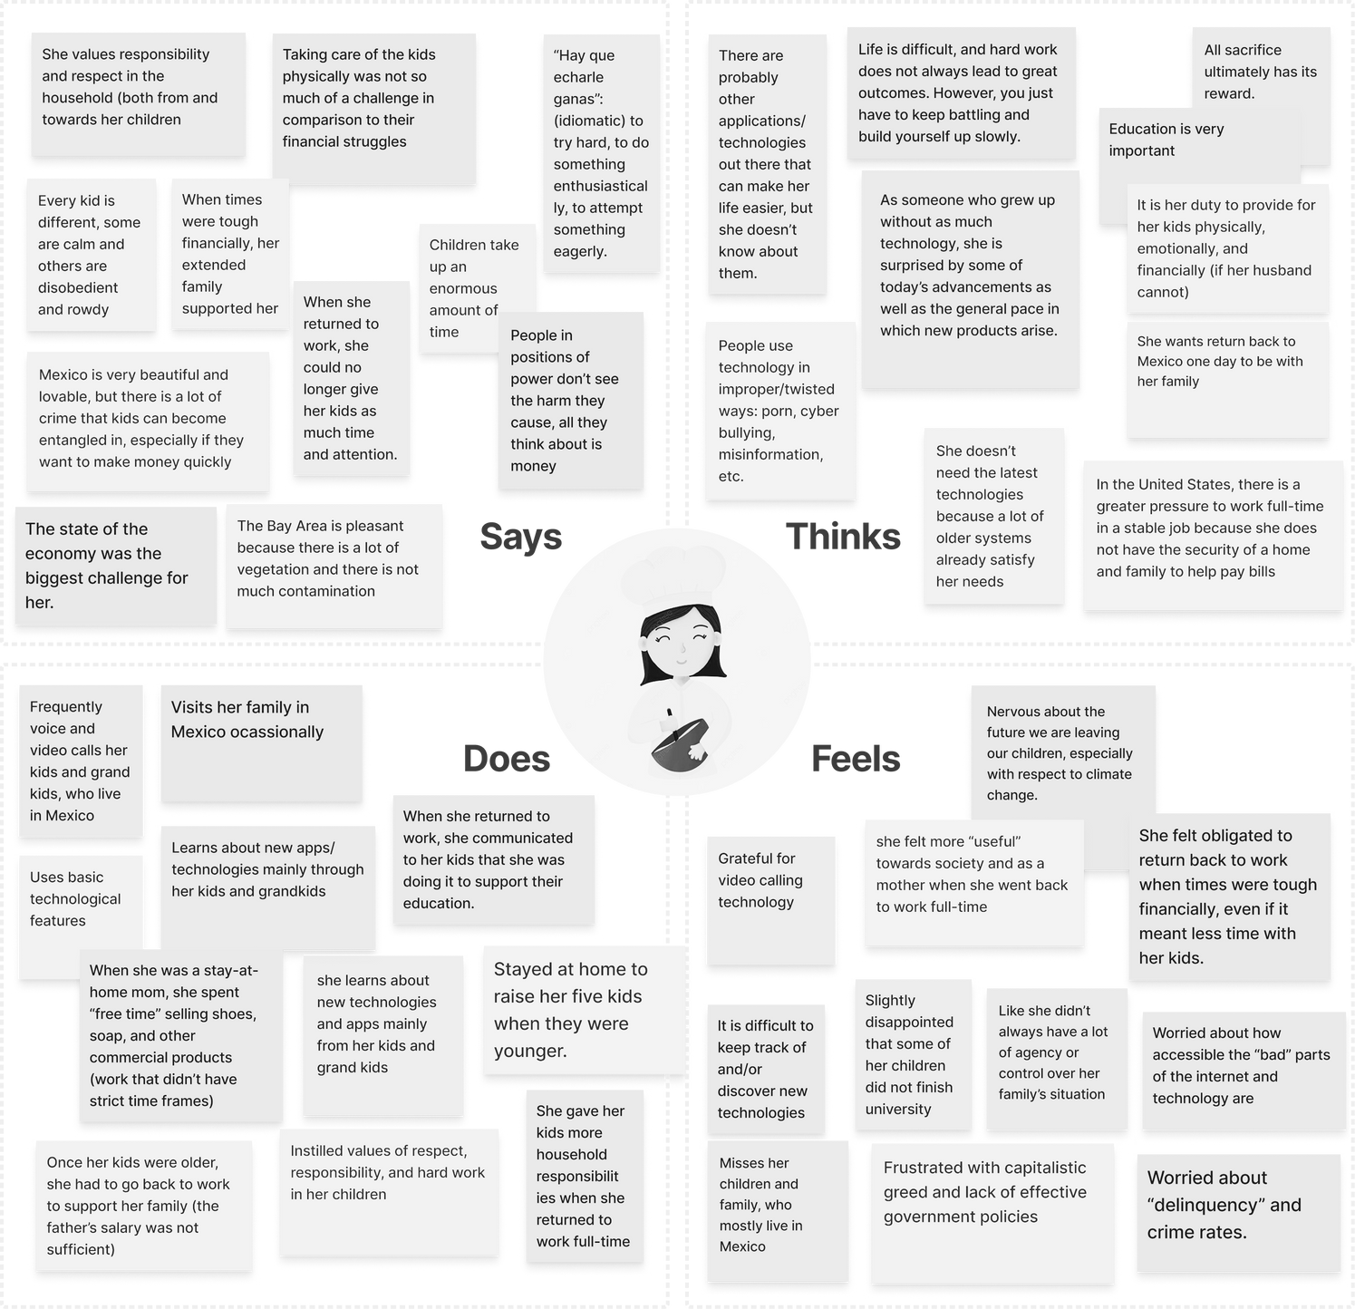
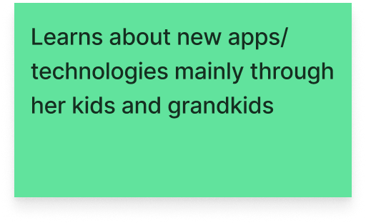
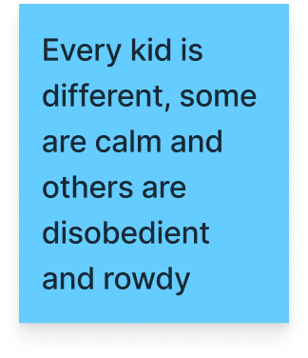
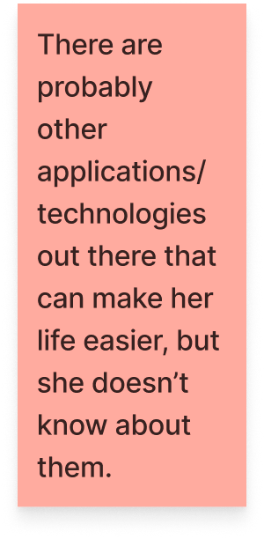
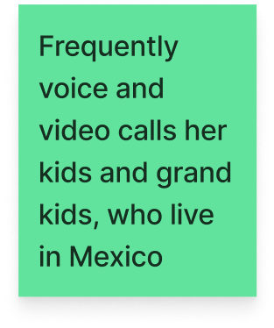
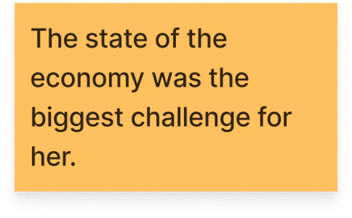
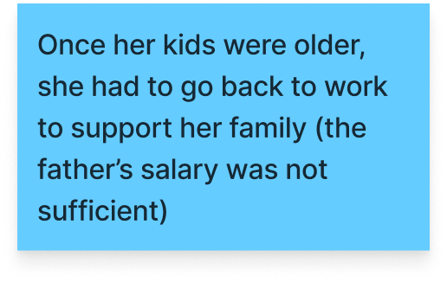
Key Insights

Slide 34
Key Quotes
“There's no one as efficient as a working mom, like, you don't want to deal with any bullsh*t. You don't want to get yourself embroiled in politics in the workplace. You want to get your sh*t done, and get it done well, and go the f*ck home.”
-Ann

Slide 35






Managing a family is like managing RA’s (very analogous problems)
Surprises
Apps/platforms that help her the most are apps that aren’t specific to mothers (ie. DoorDash, Uber)
Was so frustrated by schooling options that she wants to start her own school
Each kid is a completely different parenting experience. Much more nature than nurture.
Even hired help for the house/kids were unhelpful and created more work to do
Still heavily involved with 15 year old son’s schedule.

Slide 36


Observed
KEY INSIGHT
1
The interviewees said the most helpful products for them were Uber, Doordash, Google Drive, phone calls, etc.
Mothers’ needs are so specific that more generic and flexible tools are the most useful to them.
2
Specifically people hired to help with household tasks were still unhelpful.

Slide 37
Observed
KEY INSIGHT
1
Ann, Teresa, and Marie had difficulty with scheduling and balancing responsibilities because of the number of people they had to manage
Mothers experience similar problems to non-mothers but at a larger scale & complexity (a type of extreme user)

Slide 38
Observed
KEY INSIGHT
1
Wei and Ann only trust word-of-mouth recommendations. People who have worked for friends already know the values of the neighborhood and how to take care of a house.
Hard to communicate your needs to someone who does not experience the same problems.

Slide 39
Summary

Slide 40

Key Learnings
Mothers are already trying their best to maximize their efficiency

Slide 41
Key Learnings
Is the right answer just to design something that allows them to accomplish more work?
Mothers are already trying their best to maximize their efficiency

Slide 42

Key Learnings: Luggage Example
Iterating on existing bags (bigger, more compartments, etc.)
Creating a new type of bag with wheels

Slide 43
Key Learnings
Not just enabling mothers to do more work
but also making work distribution easier?

Slide 44
Talking to fathers, couples, and others who have similar responsibilities
(scheduling, management, logistics, etc.)
Continuing to unpack interview insights
what’s
NEXT?
Using insights to target a more specific problem within domain
HMW statements & prototyping

Slide 45
Appendix

Slide 46
Guiding Interview Questions
What surprised you most about motherhood?
What frustrated you most? What did you enjoy?
What is your daily routine (to see what processes get repeated super often)? What is the most frustrating part? What’s the most frustrating part of the routine that involves the kids?
Walk me through your mornings at home, starting from when you wake up to once you arrive at work
What is the hardest part of your daily routine? The easiest?

Slide 47
Guiding Interview Questions
Any solutions you’ve found to problems you’ve had as a mother?
What is your favorite tool/app/product/platform that you’ve used as a mother
What are some tips and tricks you would pass on to your friends/family
What are some processes you feel are redundant or inefficient?
What would make your life easier?
Favorite and least favorite parts of motherhood or your daily routine right now
What’s something you wish you could automate or have someone do for you
What childcare benefits does your company offer?

